Slide 1

Spendify
This Project & Presentation is for partial fulfilment of
Front End Engineering - II(22CS004)
Submitted By
CSE-G30/T07
Kushagra Juneja (2210990533)
Keshav Gupta (2210990505)
Lisha Goel (2210990542)
Presented To
Mr. Vikas Patel
Department of Computer Science and Engineering
Chitkara University, Punjab

Slide 2
TABLE OF CONTENT
INTRODUCTION
TECHNICAL DETAILS
KEY FEATURES
PROJECT HIGHLIGHTS
FUTURE SCOPE
CONCLUSION
BIBLIOGRAPHY

Slide 3
INTRODUCTION
“Spendify” is an expense tracker website designed to help users manage their daily expenditure more efficiently.
The website provides a user-friendly interface for users to manage all aspects of their expenditure, including categorizing the spent money and knowing the left balance.
Spendify's primary features include categorizing the spent money in a tabular form, enabling users to set budget limits and making money handling easier.

Slide 4

3
Spendify

Slide 5
Technical Details
HTML : The Hypertext Markup Language or HTML is standard markup language for documents designed to be displayed in a web browser.
CSS : CSS or cascading style sheets is used for styling and formatting HTML documents. It is used to define styles for HTML elements such as fonts, colors, spacing and layout.
JavaScript : JavaScript is a programming language used to add interactivity and functionality to websites. It is commonly used to create dynamic effects, responsive and interactive web pages.
Visual Studio Code : Visual studio code is a free and open-source code editor developed by Microsoft and is designed for building and debugging web and cloud applications.
Bootstrap : Bootstrap is a powerful, extensible, and feature-packed frontend toolkit.

Slide 6
Key features
EXPENSE TRACKING : “Spendify” is an expense tracking website. It is an online platform designed to help users manage their expenditure more efficiently.
ACCESSIBILITY : This expense tracking website, Spendify, provides users with a comprehensive toolset to help them manage their finances.
EFFICIENT : Very few resources are required to store and run the webpage.
EASY TO USE : The website is typically accessed through a web browser and provides a user-friendly interface for users to manage all their expenditure, from budgeting to categorizing expenses.
FREE TO USE : The Spendify webpage is completely free to use and can be used by anyone for any purpose (household / professional/ Business etc.)

Slide 7
project highlights
Effortless Expense Tracking: “Spendify" effortlessly tracks your daily expenses by manually entering transactions.
Smart Budget Management: “Spendify” can be utilized to set, monitor, and manage your budgets effectively.
Expense Categorization: “Spendify" allows users to categorize expenses to gain insights into spending patterns.

Slide 8
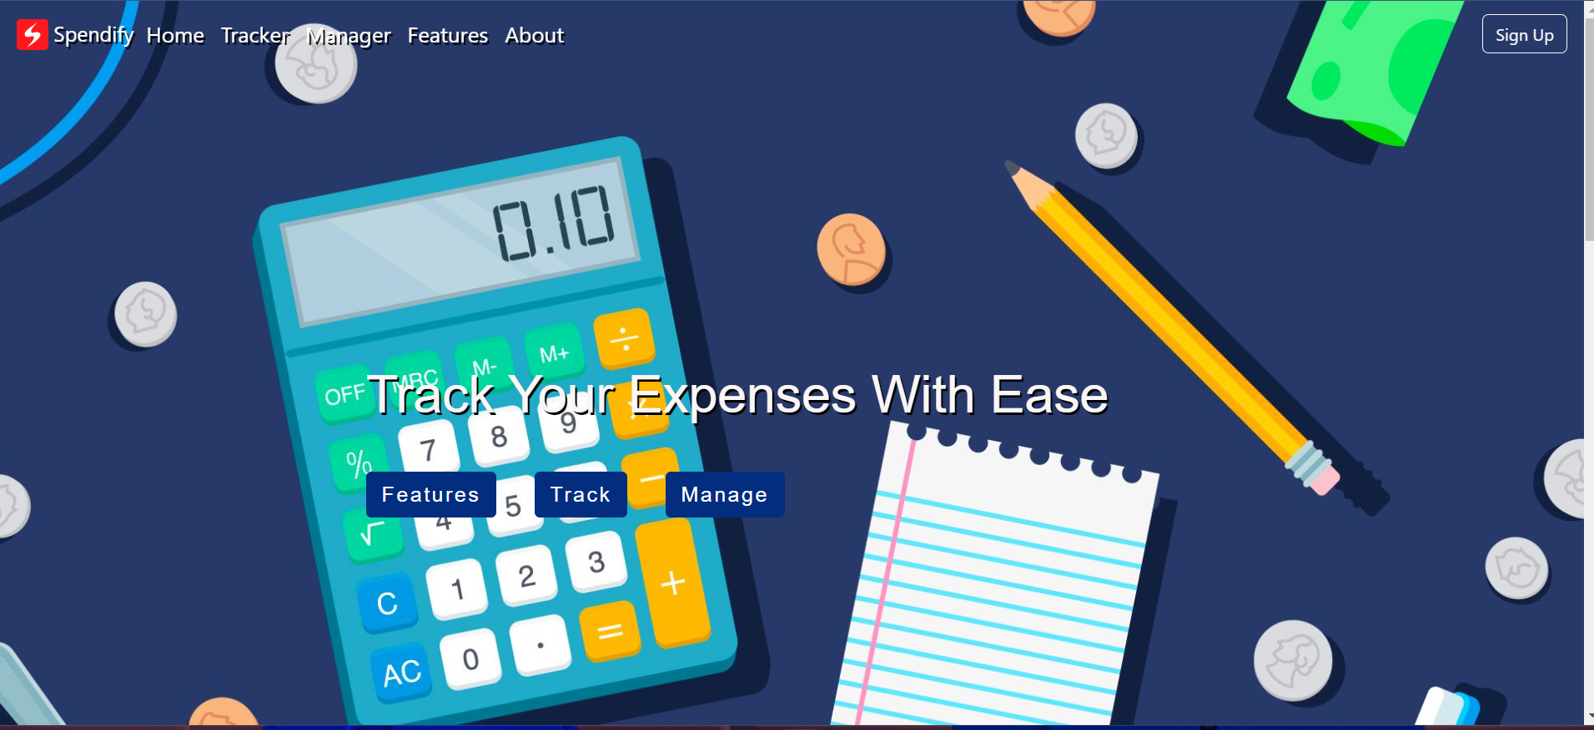

Slide 9
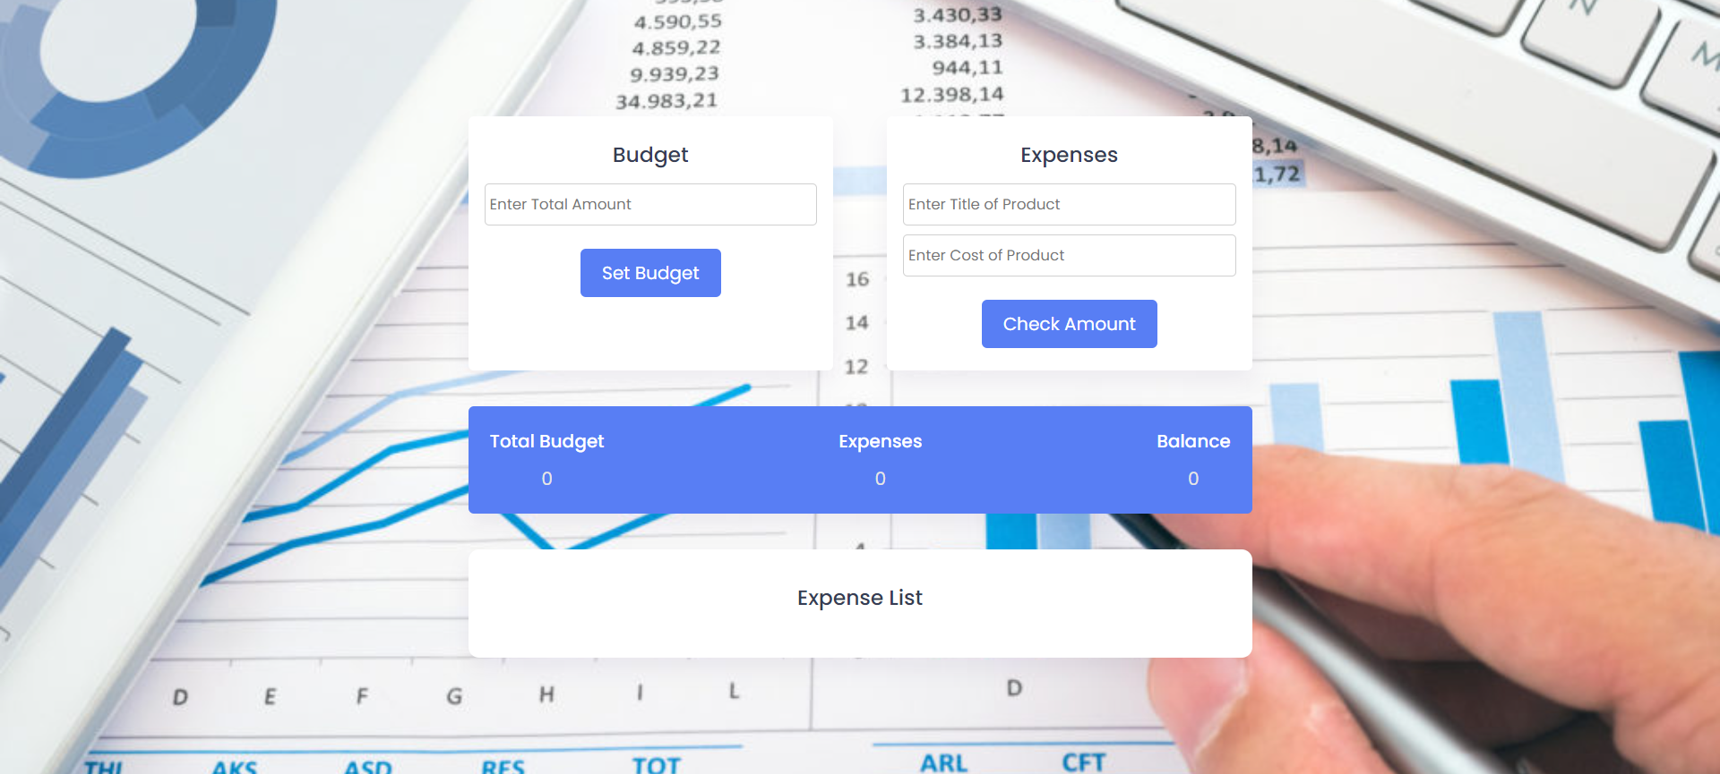

Slide 10
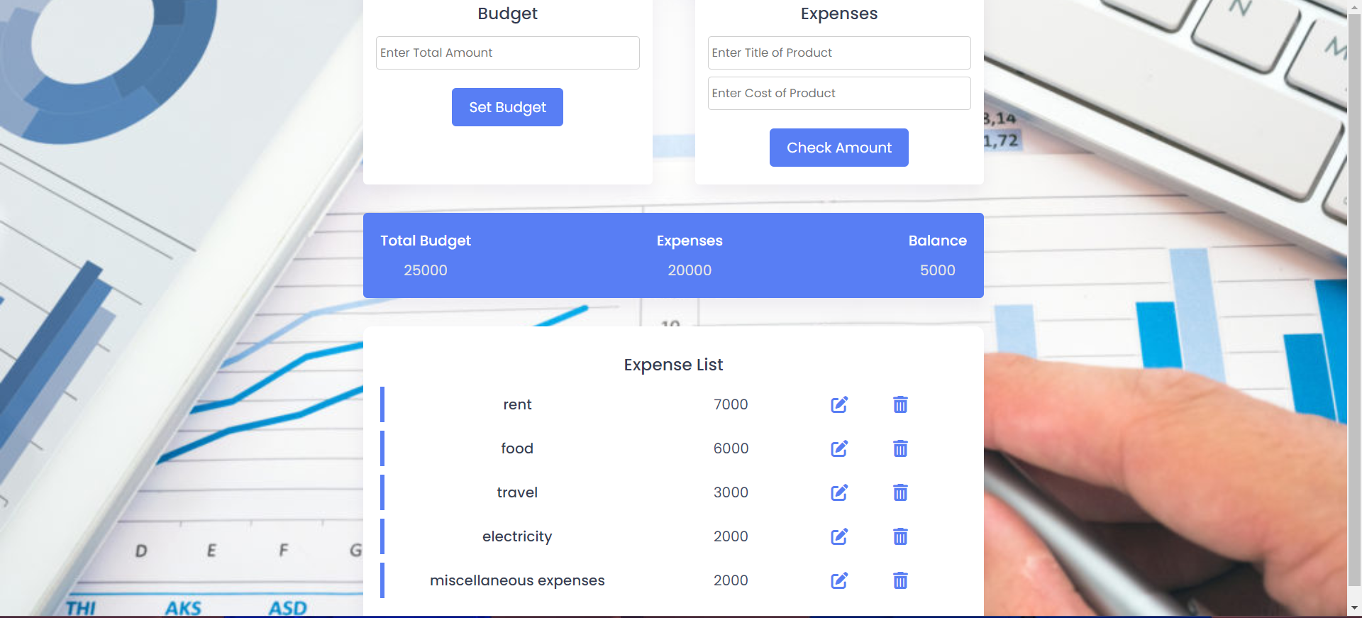
OUTPUT

Slide 11
CONCLUSION With future scope
Multi-user login capabilities, allowing friends or business partners to collaborate on expense tracking.
Integration of a bill-splitting feature.
Enhance the visualization of financial data by introducing expenditure graphs.
Improve the categorization system by allowing users to categorize expenses based on specific date ranges.
Developing a mobile application.

Slide 12
BIBLIOGRAPHY
https://en.wikipedia.org/wiki/HTML
https://www.w3schools.com/html/default.asp

Slide 13
THANK YOU
From :-
Kushagra Juneja (2210990533)
Keshav Gupta (2210990505)
Lisha Goel (2210990542)

